Slide 1

Predicting Fraudulent E-Commerce Transactions
Group 8
Notes:
Our Project Topic is the Analysis of Job Market Trends in the US.

Slide 2

Project Overview
Our project focused on detecting fraudulent e-commerce transactions using machine learning. The analysis utilized two datasets:
• Version 1: A larger dataset containing 1,472,952 transactions without a binary fraud indicator. This dataset was used for testing the trained model.
• Version 2: A smaller dataset containing 23,634 transactions, which included a binary indicator of fraudulence (1 for fraudulent, 0 for legitimate). This dataset was used for training and evaluating machine learning models.
Initially, the goal was to develop a fraud detection model with an overall prediction accuracy of 75% or higher. However, due to the highly imbalanced nature of the dataset, where fraudulent transactions comprised only 5% of the total, we shifted our focus. The revised objective prioritized recall (the ability to correctly identify fraudulent transactions) and aimed for a recall value of 75% or higher. This approach aligned with the project’s ultimate goal of minimizing missed fraudulent transactions, even if it meant tolerating a slightly higher rate of false positives.
By balancing precision and recall, our project sought to build an effective fraud detection model that could perform well on both the small training dataset and the larger test dataset.

Slide 3
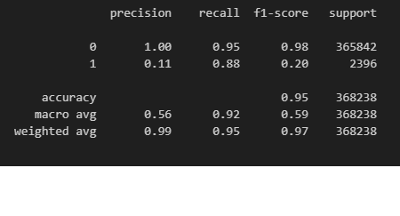
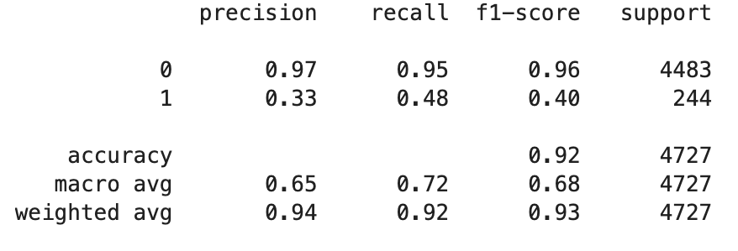
Model Selection: Logistic Regression versus Random Forest with SMOTE
Logistic Regression Model
Random Forest with SMOTE Model
Notes:
Logistic Regression Model: While we were able to achieve higher recall values for Class 1 (fraudulent transactions), there was extremely low precision, meaning it predicts more false positives, flagging legitimate transactions as fraudulent. We decided to experiment with other models to see if we could get higher precision, while maintaining a 75% or higher on the recall values.
In addition, it took about 30 minutes to run the smaller dataset of 23k records and over 2 hours to run the larger dataset of 1.4mil records. We also wanted to find a model that potentially performed better in processing time.
Random Forest Model with SMOTE: To account for the imbalanced datasets, where the minority class is underrepresented, we incorporated SMOTE with our random forest model, which generated synthetic samples of the minority class to balance the data. However, it did not achieve the high recall values we were looking to obtain while improving precision.
*SMOTE (Synthetic Minority Oversampling Technique):
SMOTE is a data augmentation technique used to address class imbalance in datasets, especially in machine learning problems. It generates synthetic samples for the minority class by interpolating between existing minority class samples, rather than simply duplicating them. (looking at the 5 nearest neighbors by default)
*Model selection was based on training and testing on smaller dataset 23k records

Slide 4
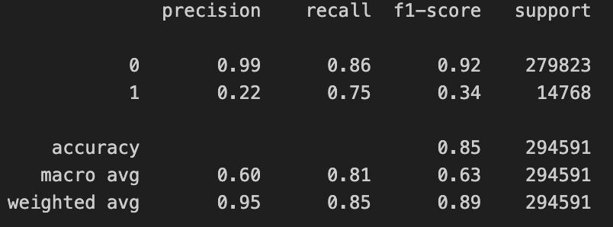
Model Selection: Random Forest with SMOTE versus XGBoost
Random Forest with SMOTE Model
XGBoost Model
Notes:
XGBoost Model: The XGBoost model outperformed the Random Forest model with SMOTE in recall (75% versus 48%) for Class 1, fraudulent records. While this model is comparable to the original Logistic Regression model, the optimized performance and speed with which it is able to run our larger datasets made it the winning choice in the selection process.
*XGBoost (Extreme Gradient Boosting):
XGBoost is a gradient-boosting algorithm designed for optimized performance and speed. It sequentially builds decision trees, correcting errors made by previous trees. Instead of using SMOTE, XGBoost addresses class imbalance through its scale_pos_weight parameter, which adjusts the importance of the minority class.
*Model selection was based on training and testing on smaller dataset 23k records

Slide 5
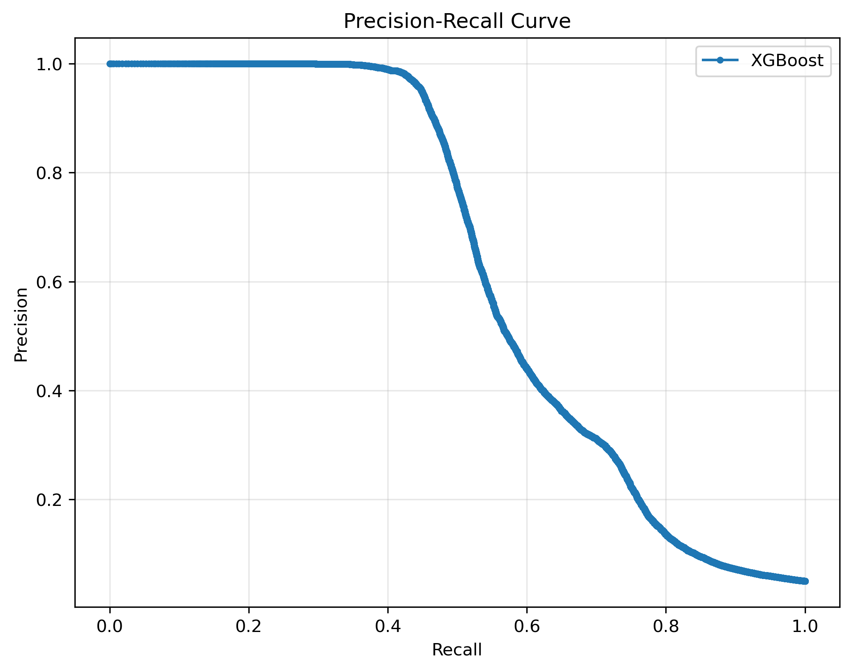
Precision-Recall Curve with XGBoost
Notes:
1. High Precision at Low Recall:
On the left side of the curve, the precision is close to 1.0 when recall is very low. This indicates that when the model predicts very few transactions as fraudulent, it is mostly correct (fewer false positives). However, it is missing a lot of actual fraudulent transactions.
2. Trade-Off:
As recall increases (moving right along the x-axis), the precision decreases. This is because, to catch more fraudulent transactions, the model starts predicting more transactions as fraudulent, which increases false positives.
3. Model Performance:
The area under the curve gives a sense of how well the model performs. If the curve stays high (closer to 1.0), it indicates that the model maintains a good balance between precision and recall. A steep drop-off in precision as recall increases may indicate a trade-off between identifying true positives and avoiding false positives.
4. Application-Specific Decision:
Depending on the use case, you might prioritize precision (e.g., to minimize false alarms in fraud detection systems where false positives are costly) or recall (e.g., to ensure all fraudulent transactions are flagged).

Slide 6
Conclusion
The XGBoost model was decided to be the most effective solution for detecting fraudulent e-commerce transactions based on accuracy and speed. While the original goal of achieving 75% overall prediction accuracy was reconsidered due to the imbalanced dataset, the new focus on recall ensured the detection of a significant proportion of fraudulent transactions.
The final model provided a recall of 75%, which means 3 out of 4 fraudulent transactions were correctly identified. This result demonstrates the model’s effectiveness in high-stakes scenarios where missing fraudulent cases is costlier than flagging legitimate ones. The decision threshold can be adjusted to optimize the balance between precision and recall, allowing for quick adaptability to business needs, while maintaining speed and scalability for large-scale datasets.

Slide 7

Thank you

